Slide 1
Can
Neural Networks solve 2+2?
Marusic Diana

Slide 5
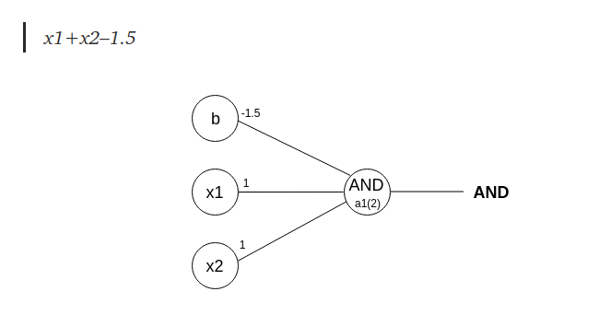
Perceptron
https://medium.com/@stanleydukor/neural-representation-of-and-or-not-xor-and-xnor-logic-gates-perceptron-algorithm-b0275375fea1
From w1x1+w2x2+b,

Slide 6
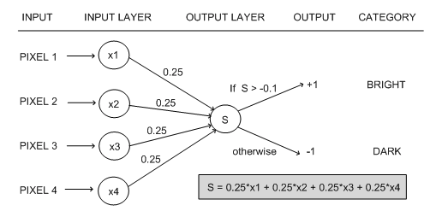
Perceptron
Sursa: https://towardsdatascience.com/what-the-hell-is-perceptron-626217814f53

Slide 7
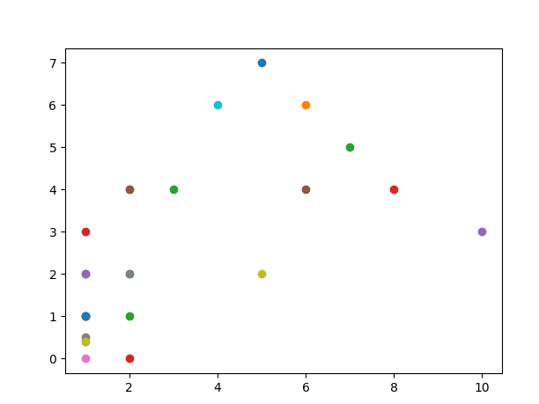
Perceptron

Slide 8
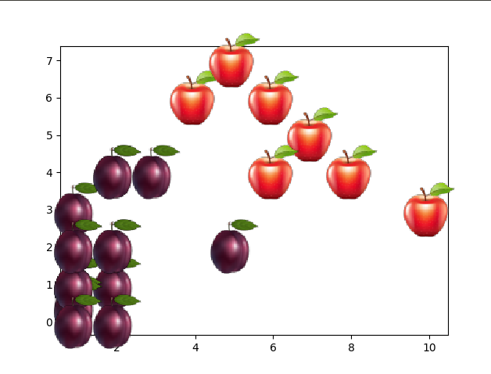
Perceptron

Slide 9
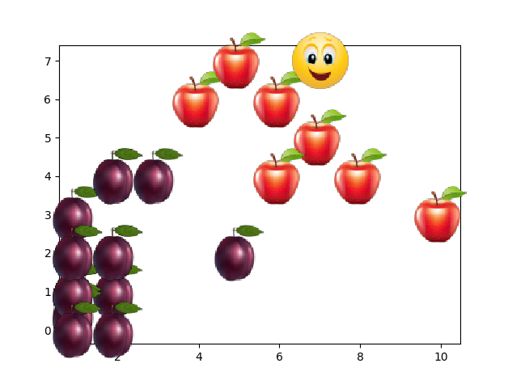
Perceptron

Slide 10
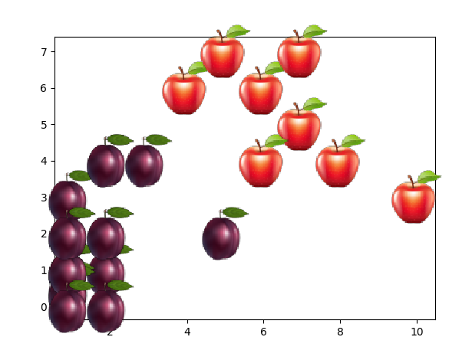
Perceptron

Slide 11
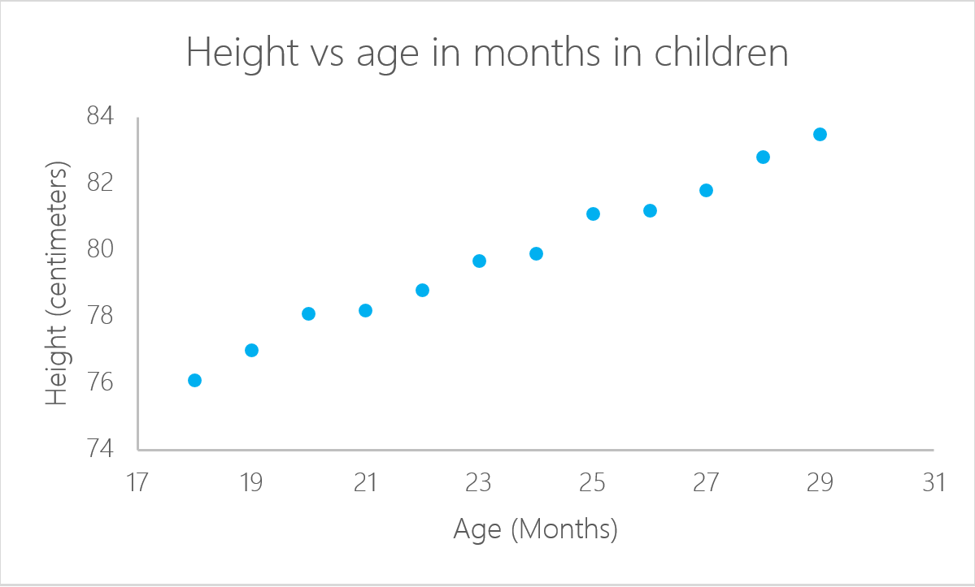
Perceptron
Sursa: https://www.datacamp.com/community/tutorials/linear-regression-R

Slide 12
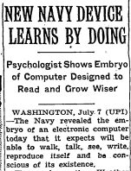
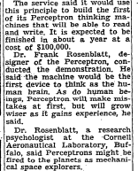
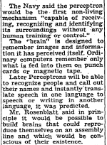
Perceptron
Sursa: http://jcblackmon.com/wp-content/uploads/2018/01/MBC-Rosenblatt-Perceptron-NYT-article.jpg.pdf

Slide 15
Technologies
Matlab
Sklearn
Tensorflow (by Google)
PyBrain
C++

Slide 16
Applications
https://medium.com/@datamonsters/artificial-neural-networks-in-natural-language-processing-bcf62aa9151a
https://medium.com/@jayeshbahire/real-world-applications-of-artificial-neural-networks-a6a6bc17ad6a
Fraud detection in banks
Sentiment and emotion analysis

Slide 17
Applications
Image recognition
Fraud detection in banks
Self driving cars
Language-driven image generation
https://blog.statsbot.co/neural-networks-for-beginners-d99f2235efca

Slide 18
Applications
Marketing:
Segmenting customers according to basic characteristics including demographics, economic status, location, purchase patterns, and attitude towards a product. Unsupervised neural networks can be used to automatically group and segment customers based on the similarity of their characteristics, while supervised neural networks can be trained to learn the boundaries between customer segments based on a group of customers.
https://blog.statsbot.co/neural-networks-for-beginners-d99f2235efca

Slide 19
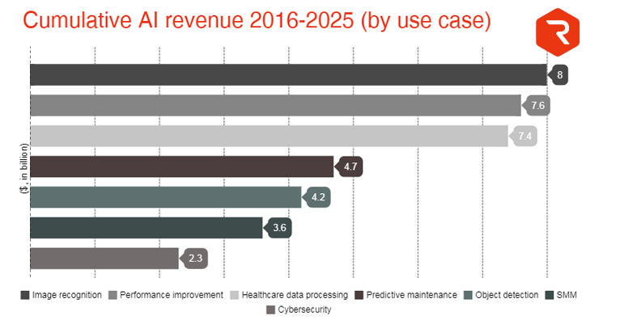
Applications
Source: https://www.upwork.com/hiring/for-clients/build-neural-network-actually-need-one/

Slide 20
Google AI translates same voice

Slide 21
Text Understanding from Scratch
This article demonstrates that we can apply deep
learning to text understanding from characterlevel
inputs all the way up to abstract text
concepts, using temporal convolutional networks(LeCun
et al., 1998) (ConvNets
https://arxiv.org/pdf/1502.01710.pdf

Slide 22
RNN
Recipe summarization
https://github.com/rtlee9/recipe-summarization

Slide 23
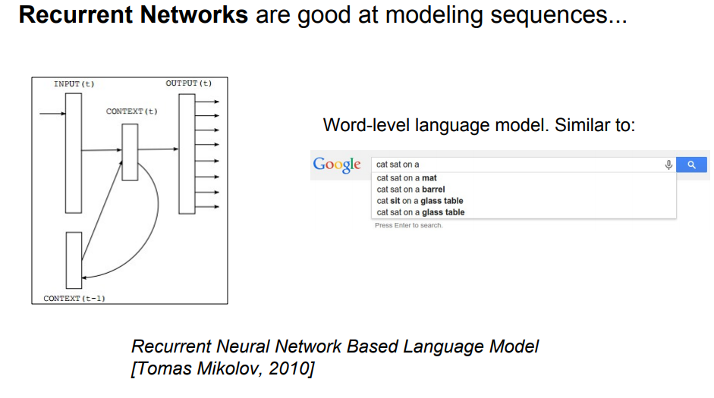

Slide 24
Recipe datasets
https://eightportions.com/datasets/Recipes/#fn:1

Slide 25
DeepFake sau dans real time

Slide 26
RNN applications
Image captioning
https://www.researchgate.net/publication/308303415_Image_Caption_Generation_using_Recurrent_Neural_Network
https://cs.stanford.edu/people/karpathy/sfmltalk.pdf

Slide 27
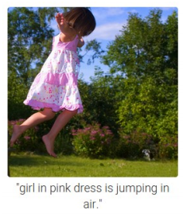
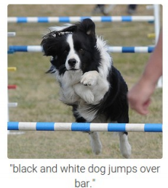
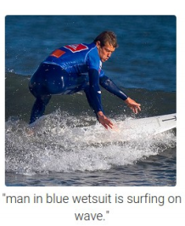
Image captioning
Sursa: https://cs.stanford.edu/people/karpathy/sfmltalk.pdf

Slide 28
Google Deepmind AI walks
https://youtu.be/gn4nRCC9TwQ

Slide 29
github/mdiannna/???? marusicdiana@gmail.com

Slide 30
Mulţumesc pentru atenţie!

